Slide 1


KCCEMSR, THANE
Microstrip Antenna Design for AR/VR Devices
For the Degree of Bachelors of Electronics & Telecommunication
Tanmay Chimankar Mayur Mane Mitesh Sawant Vaishnavi Wadkar
Roll No: 05 Roll No: 27 Roll No:46 Roll No:55
Guided by : Anupama Chaurasia (Asst Professor EXTC )
Department of Electronics & Telecommunication Engineering K. C. College of Engineering & Management Studies & Research, Thane (E) 25/04/2025

Slide 2
KCCEMSR, THANE
Introduction
Augmented Reality (AR) and Virtual Reality (VR) are immersive technologies that enhance or simulate environments.AR overlays digital content on the real world via devices like smartphones or HoloLens. VR creates a fully virtual world using headsets like Meta Quest or HTC Vive.
They’re widely used in gaming, education, healthcare, and training. Together, they’re reshaping how we interact with digital and physical spaces.This project focuses on designing a compact and highly efficient antenna tailored for AR/VR devices. The antenna ensures strong signal performance while maintaining a small footprint suitable for wearable tech. It aims to enhance wireless connectivity and user experience in immersive environments.
We need this topic because the rapid growth of the AR/VR market, projected to reach $209.2B by 2029, demands advanced wireless solutions. Technologies like 5G and mmWave require compact, efficient antennas with low latency and high data rates. Microstrip patch antennas, especially in the 24–30 GHz range, are ideal for AR/VR devices due to their low-profile design and ease of integration. These project is essential to optimize their performance and enhance the overall user experience in immersive applications.

Slide 3
KCCEMSR, THANE
Project Need: Enhancing AR/VR Device Connectivity
1
Addressing Limitations
2
Miniaturization Demand
3
Improving User Experience
Current AR/VR devices have bulky antennas and limited bandwidth, which results in signal loss.
Demand for miniaturized, high-performance antenna solutions is very high, without compromising performance.
Enabling untethered AR/VR experiences enhances gaming and enables advanced remote collaboration.

Slide 4
KCCEMSR, THANE
Literature Review
Topics | Technology | Year
AR VR technology in Education. | Display Technology: OLED, LCD, and MicroLED screens for high-resolution visuals | FEBRUARY 2023
Evolution of AR VR Technology | Tracking Systems: Inside-out and outside-in tracking using cameras | APRIL 2023
Antenna design for 5g communication | Connectivity: Wireless technologies like Bluetooth, Wi-Fi, and 5G for data transmission | OCTOBER 2017
Design of rectangular microstrip patch antenna | Haptics: Feedback systems for tactile interaction, like vibrations in controllers. | MARCH 2016
Ultra-Wideband MIMO Antennas: Latest Advances in Design and Technology. | Artificial Intelligence: AI for environment mapping, object recognition, and interaction enhancement | AUGUST 2023
Antenna Artificial Intelligence: The Relentless Pursuit of Intelligent Antenna Design. | Sensors: Accelerometers, gyroscopes, and magnetometers for detecting head and body movements. | OCTOBER 2022

Slide 5
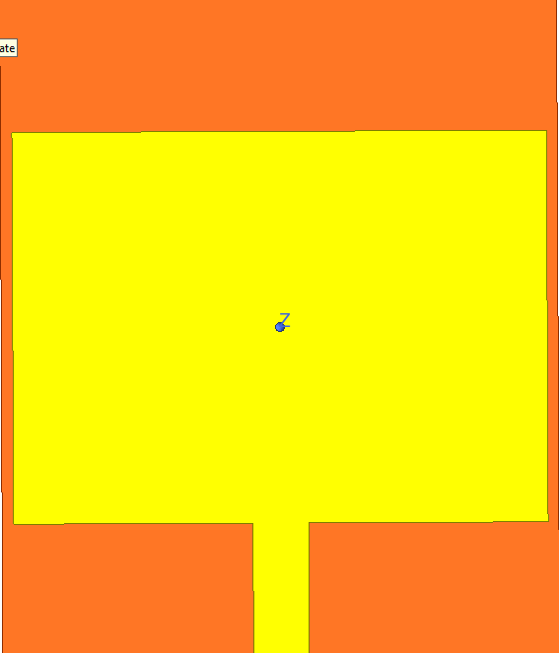


KCCEMSR, THANE
Design: Slotted Rectangular Patch Antenna
Antenna Configuration: Slotted Rectangular Patch Microstrip Antenna with specified patch dimensions.
Substrate Material: Rogers RT/Duroid 5880, dielectric constant (εr): 2.2, specified thickness.
Optimized for a specified frequency band, e.g., 24-30 GHz mmWave band, enhancing connectivity.
Fig: 1
Fig: 2
Fig: 3

Slide 6
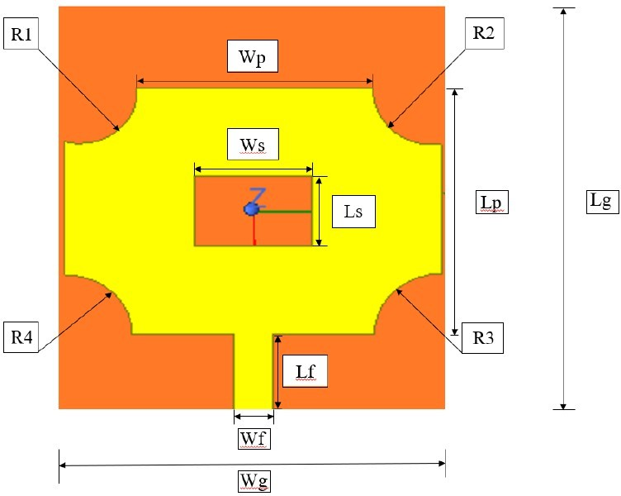
KCCEMSR, THANE
Geometry of proposed antenna structure
Parameter | Symbol | Value (mm) | Parameter | Symbol | Value (mm)
Ground Length | Lg | 6.0 | Substrate Width | Ws | 6.0
Ground Width | Wg | 5.0 | Substrate Length | Ls | 6.0
Patch Width | Wp | 4.8 | Slot Length | Lslot | 1.0
Patch Length | Lp | 3.5 | Slot Width | Wslot | 1.5
Feedline Width | W_{f} | 0.5 | Circle1 | C1 | 0.72
Feedline Length | L_{f} | 2.0 | Circle2 | C2 | 0.76
Circle4 | C4 | 0.85 | Circle3 | C3 | 0.85
Fig: 4

Slide 7
KCCEMSR, THANE
Parametric Analysis: Bandwidth
PARAMETER | VALUES OF SLOTTED RECTANGULAR PATCH | REMARK
Design | Slotted Rectangular Patch antenna | Works well with Flexible Substrate
Dimensions | 6x6x0.65mm | Equal side lengths ensure a balanced surface current distribution
Operating Frequency | 26 GHz | Lower Interference
Bandwidth | 1.8 GHz | Faster Data Rate
Electric Field between Antenna | Directional | Opposing Surface Charges
Dielectric Constant (εr) | 2.2 | Smaller Antenna Size
Material | Rogers RT/duroid 5880 (tm) | Moderate Cost

Slide 8
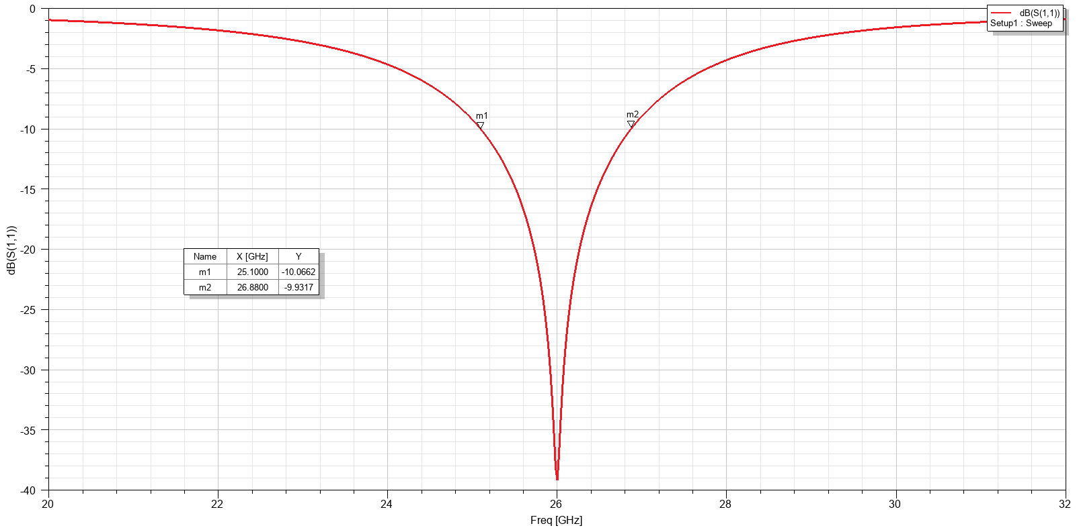
KCCEMSR, THANE
Results
Fig: 5
S11 Parameter
The graph displays signal reflection (S11 in dB) across frequencies—lower values mean better signal absorption. The lowest point around 26 GHz indicates the device performs best there, with minimal signal reflection.
Markers: 1. m1 at 25.1 GHz: −10.07 dB
2. m2 at 26.88 GHz: −9.93 dB
[These show performance near the optimal frequency.]

Slide 9
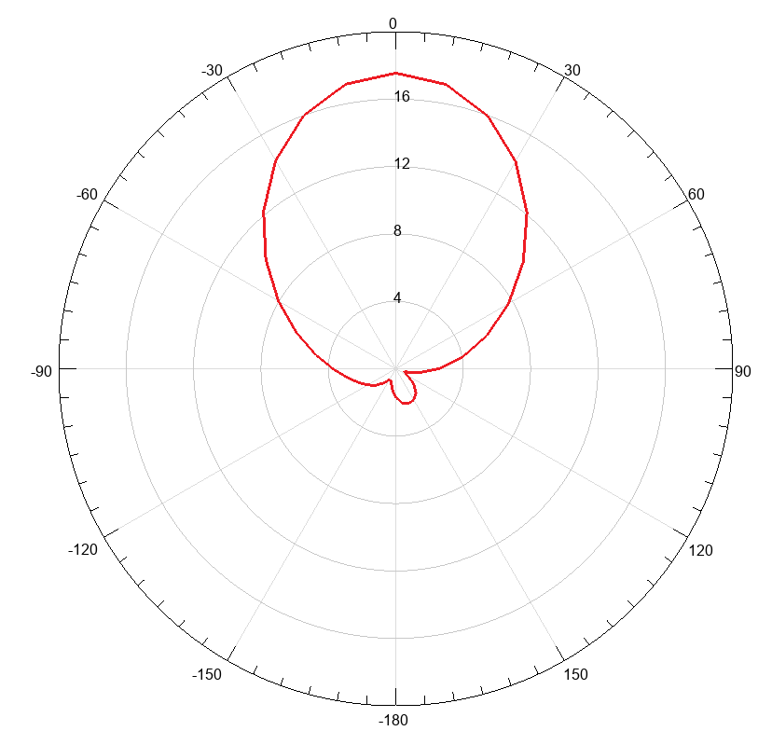
KCCEMSR, THANE
Results
The figure shows the antenna's simulated radiation pattern with a main lobe peak gain of 16.5–17 dB at 0°, indicating strong forward radiation.
A small back lobe at 180° suggests minimal radiation in the opposite direction.
This directional behavior highlights the antenna’s efficiency.
Such characteristics are ideal for AR/VR applications requiring precise signal transmission.
Fig: 6 Radiation Pattern

Slide 10
KCCEMSR, THANE
Future Scope: Advancements and Applications
1
Metamaterials
2
AI and Adaptive Beam Steering
Integration of Metamaterials improves gain, bandwidth, and radiation characteristics. Metamaterials manipulate electromagnetic waves to enhance performance while keeping the antenna size small.
Beam Steering and Beamforming Techniques are used for adaptive AR/VR applications.
AI-based antenna tuning dynamically optimizes beam direction for minimal interference and lower latency.
MIMO Integration:
4
Multi-Band Designs
3
We can enhance the design by adding multiple antennas (MIMO), which allows the device to send and receive more data at once. This improves speed, reduces lag, and ensures a more stable connection—perfect for smooth and immersive AR/VR experiences.
Multi-Band and Wideband Antenna Designs support multiple wireless standards in a single antenna.

Slide 11
KCCEMSR, THANE
Conclusion
The slotted rectangular patch antenna offers a great mix of compact size, wide bandwidth, and high efficiency, making it ideal for modern wireless systems.
Its simple structure allows easy integration into various devices. With growing demand in areas like 5G, IoT, and wearable tech, this antenna has strong potential for future innovations.
As technology evolves, it’s exciting to see how designs like this will shape next-gen communication. Continued research will likely unlock even more advanced capabilities. Overall, it’s a promising solution for the future of connectivity.
Thank you for your time and attention!

Slide 12
KCCEMSR, THANE
References
[1] C. A. Balanis, Antenna Theory: Analysis and Design, 4th ed. Hoboken, NJ, USA: Wiley, 2016.
[2] K. L. Wong, “Planar antennas for wireless communications,” Wiley-Interscience, 2003.
[3] T. Rappaport et al, “Millimeter wave mobile communications for 5G cellular: It will work!,” IEEE Access, vol. 1, pp. 335– 349, 2013.
[4] H. Nakano et al, “A wideband slot antenna backed by an electromagnetic band-gap (EBG) structure,” IEEE Antennas Wireless Propag. Lett, vol. 10, pp. 361–364, 2011.
[5] S. Zhu and R. Langley, “Dual-band wearable textile antenna on an EBG substrate,” IEEE Trans. Antennas Propag, vol. 57, no. 4, pp. 926–935, Apr. 2009.
[6] Y. Lo and S. W. Lee, Antenna Handbook: Theory, Applications, and Design. Springer, 1993.
[7] H. Oraizi and S. Jam, “Miniaturization of microstrip antennas by the novel application of the Fibonacci sequence,” IEEE Trans. Antennas Propag, vol. 60, no. 5, pp. 2305–2311, 2012.
[8] M. S. Sharawi, “Printed multi-band MIMO antenna systems and their performance metrics,” IEEE Antennas Propag. Mag, vol. 55, no. 5, pp. 218–232, Oct. 2013.
[9] J. Liu et al, “Design of compact and high-gain 60 GHz slotted patch antennas,” IEEE Antennas Wireless Propag. Lett, vol. 16, pp. 169–172, 2017.
[10] S. H. Lee and J. I. Lee, “A slot-loaded patch antenna for 60-GHz applications,” Microw. Opt. Technol. Lett, vol. 51, no. 6, pp. 1482–1484, 2009.
[11] D. M. Pozar, Microwave Engineering, 4th ed, Wiley, 2011.
[12] A. Kiourti and J. L. Volakis, “High-efficiency antennas for implantable devices: Design, performance, and application,” IEEE Antennas Propag. Mag, vol. 56, no. 3, pp. 84–93, Jun. 2014.

